Slide 1
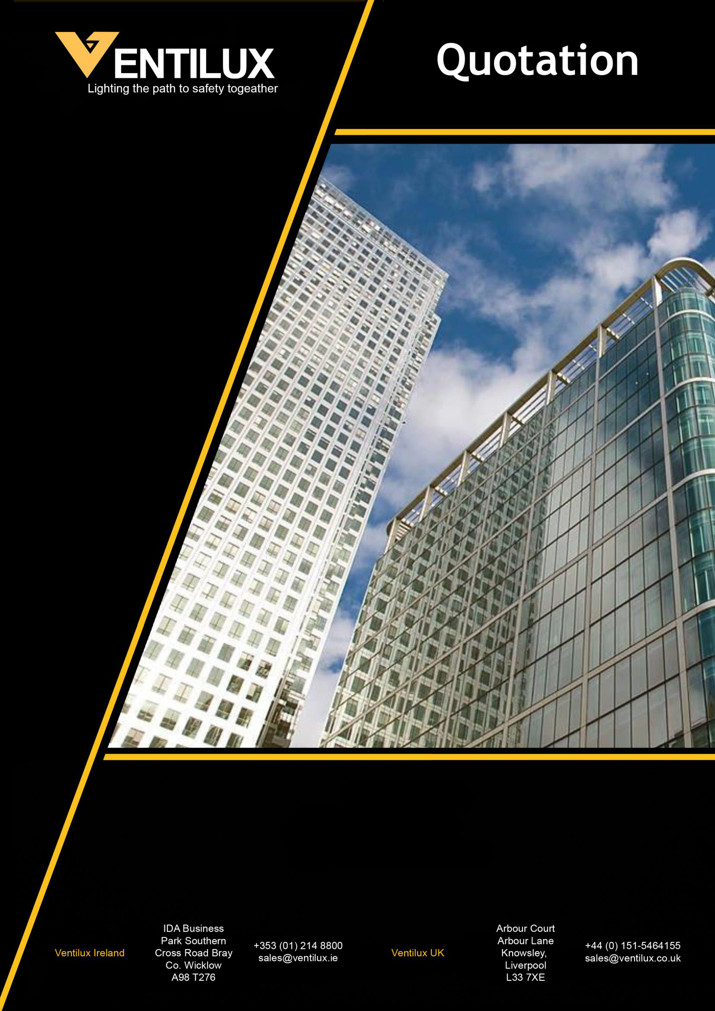
Project Name:
Prepared By:
Date:

Slide 2


Slide 3


Slide 4
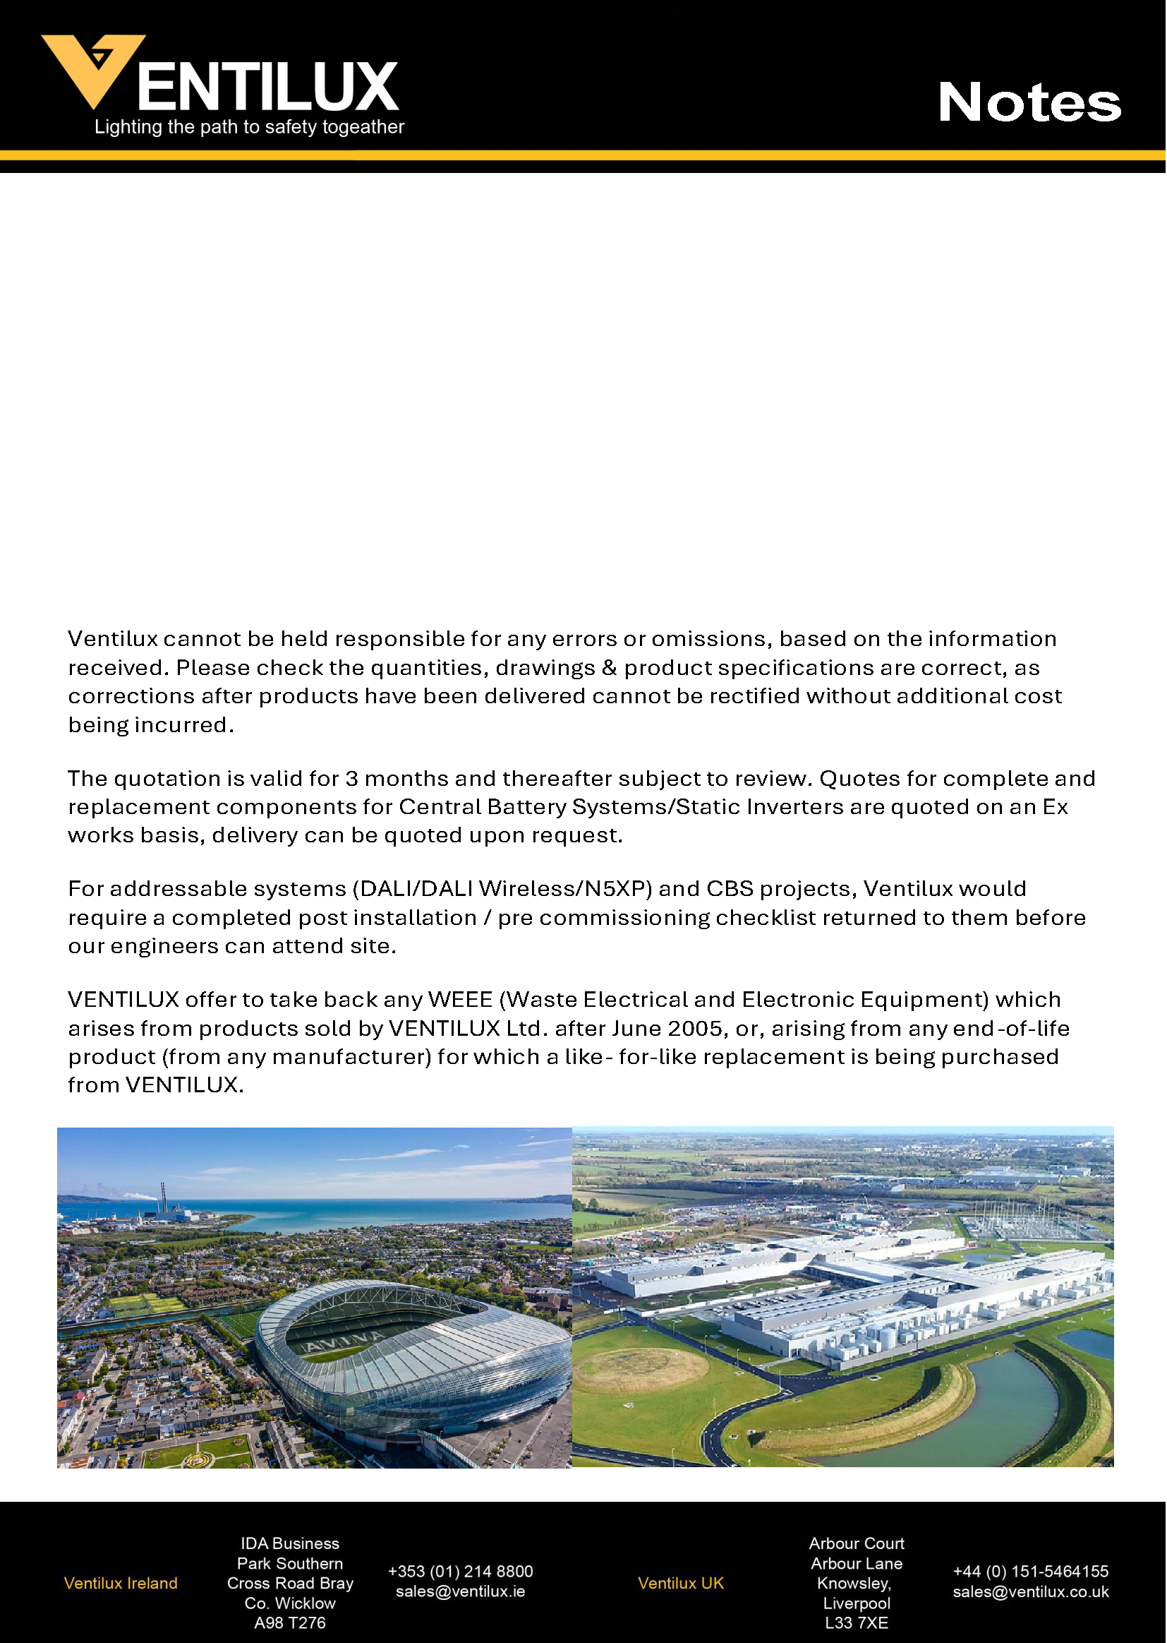
SAL-119-04
NDCO: 2564

